Slide 1
CS 2200
LAB 1

Slide 2
Brief Overview:
Course Introduction, LC2200, Endianness, Packing, CircuitSim

Slide 3
Announcements
Office hours started this week, check Canvas homepage for schedule
Homework 1 will be released after lab, and is due Jan 24th @ 6:15 PM
Project 1 will be released Friday and is due Feb 9th @ 11:59 PM

Slide 4
About the TA’s

Slide 5

Academic Infractions
Automatic 0 on the assignment and reported to OSI
Late days in syllabus, so there is no need to cheat and rush
It is better to turn in nothing and get a 0 than commit an academic infraction and get a 0 and a report
Unfortunately, several students are caught every semester
OSI will not allow students to drop a course if they committed an academic infraction
If you can google something, so can we

Slide 6
Instruction Set Architecture

Slide 7
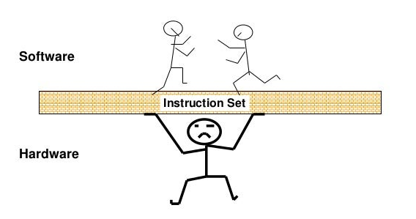

Slide 8
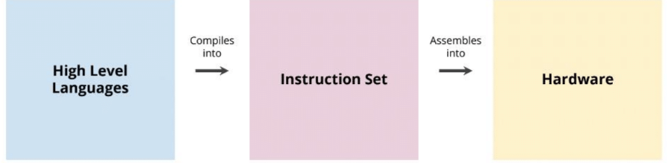
Instruction Set
A “middleman” between software and hardware.
Defines an interface for control.
A hardware CPU will implement an ISA.
Abstracts architectural knowledge from the compiler.
Ex: x86, ARM, RISCV, MIPS, POWERPC, etc …

Slide 9
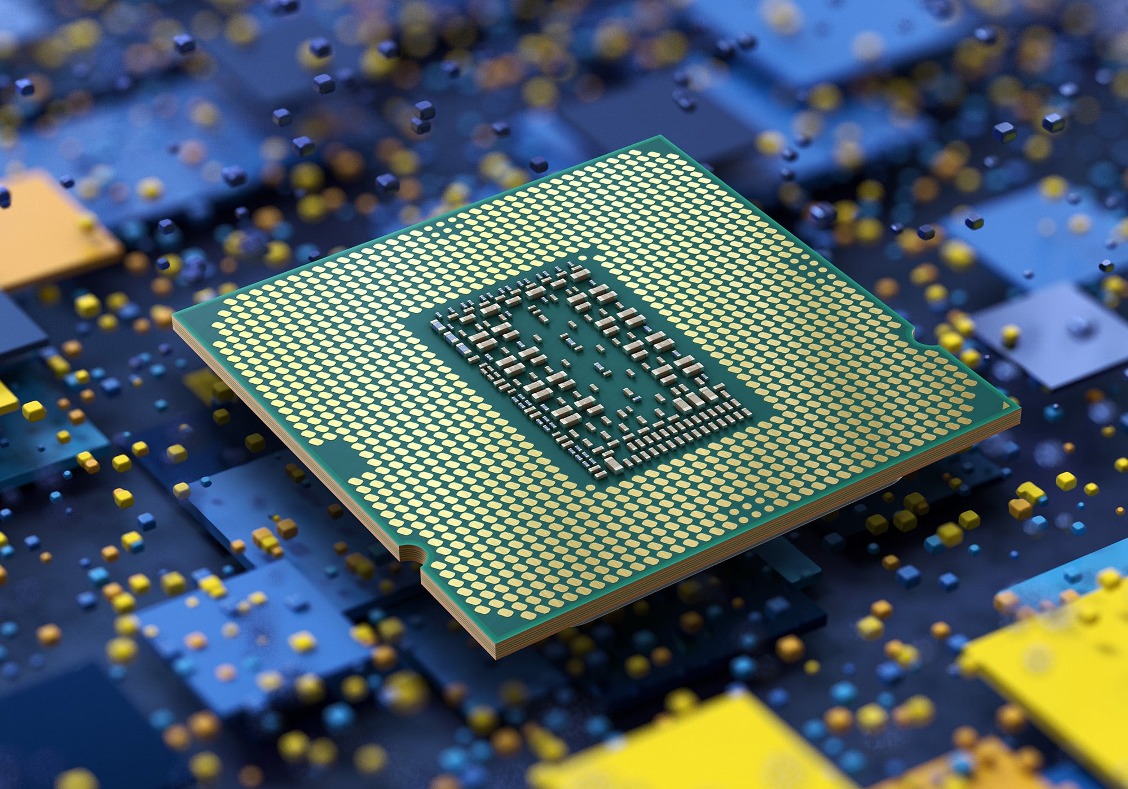
LC-2200 Architectural Details
32-bit Architecture
Word Addressable
Little Endian
Fixed Length (32 bit) Instructions
16 General Purpose Registers
Load-Store Architecture
All data operations occur on registers

Slide 10
Addressing Mode
The format of the instructions, and how the data within them is accessed.
LC-2200 has 4 main types
R-type (Register)
I-type (Immediate)
J-type (Jump)
O-type also exists, but its sole use is NOP
Indicates no operands at all!

Slide 11
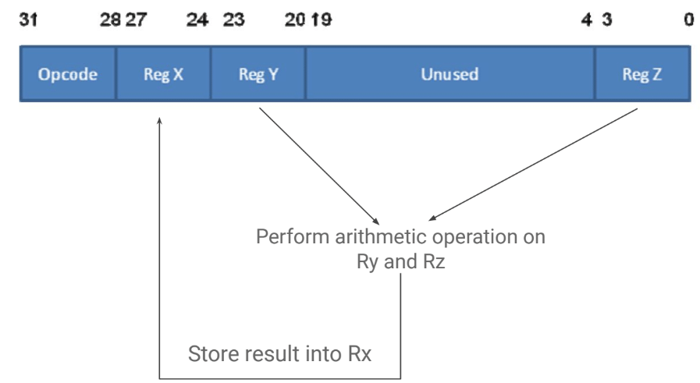
R-Type Instructions
Uses 3 operands contained in registers.
ADD $v0, $a0, $a1
Opcode 0b0000
NAND $v0, $a0, $a1
Opcode 0b0001

Slide 12
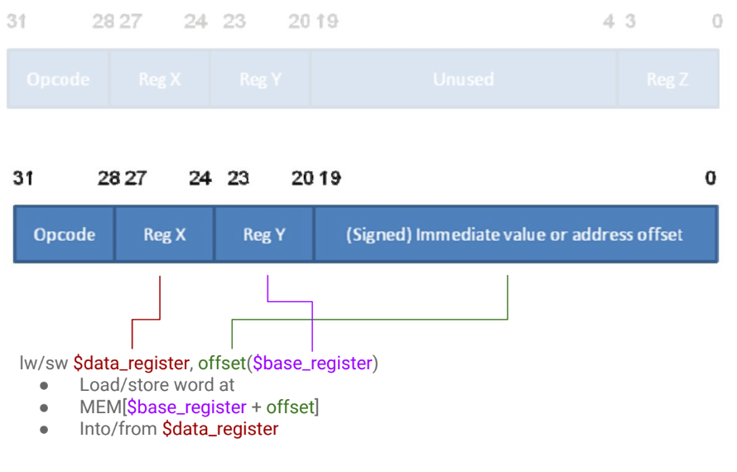
I-Type Instructions
Uses an immediate value in the instruction, not one pulled from a register or memory.
ADDI $v0, $a1, 1
Opcode 0b0010
LW $v0, 0x2($a1)
Opcode 0b0011
SW $v0, 0x2($a1)
Opcode 0b0100
BEQ $a0, $a1, LABEL
Opcode 0b0101

Slide 13
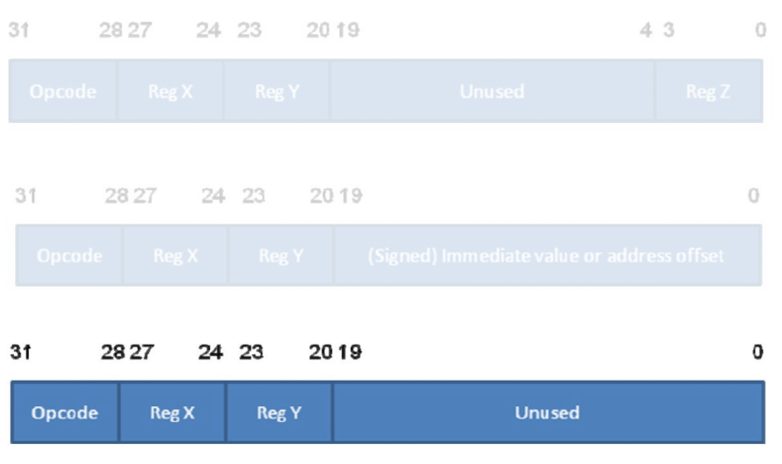
J-Type Instructions
Uses exactly two registers, the rest of the instruction space is unused.
JALR $at, $ra
Stores the current PC in $ra, then jumps to $at

Slide 14
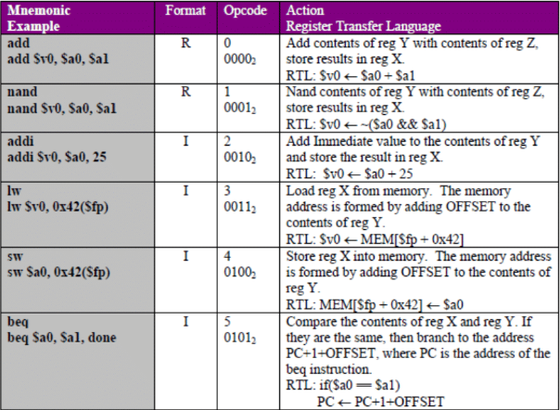
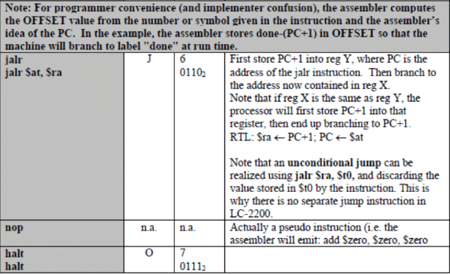
LC 2200 Instruction Set

Slide 15
Endianness & Packing

Slide 16
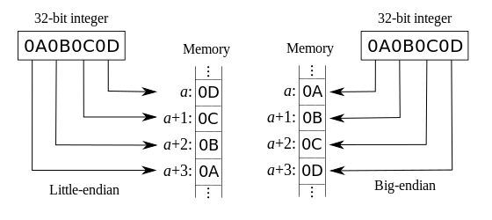
Endianness
Endianness defines how the system will organize the bytes that make up numbers. All data is comprised into chunks of bytes, with the largest byte in the number called the Most Significant Byte (MSB), and the smallest byte called the Least Significant Byte (LSB).
Big Endian = The most significant byte is at the lowest memory address
Little Endian = The least significant byte is at the lowest memory address

Slide 17
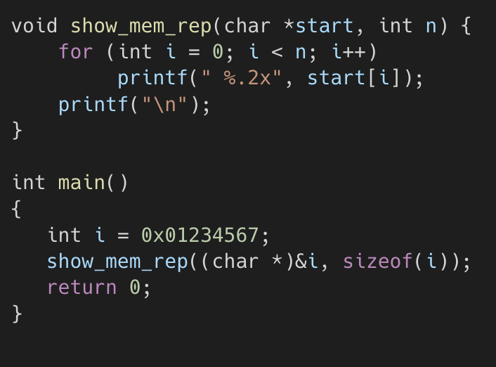
Endianness In C
If the computer that is running the program is little endian, what would the expected output be?
Similarly what would the output be for a big endian system?

Slide 18
Endianness In C
If the computer that is running the program is little endian, what would the expected output be?
67 45 23 01
Similarly what would the output be for a big endian system?
01 23 45 67

Slide 19
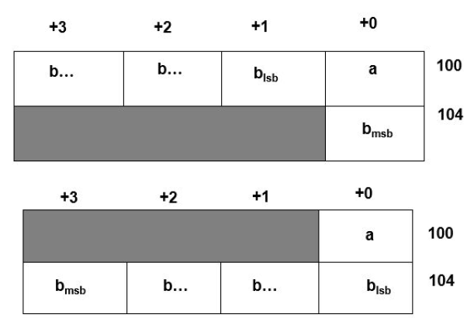
Packing
Processors can only read 1 word in a single cycle - 4 bytes / 32 bits.

Slide 20
Packing
Processors can only read 1 word in a single cycle - 4 bytes / 32 bits.
Unaligned access to memory are expensive.

Slide 21
Packing
Processors can only read 1 word in a single cycle - 4 bytes / 32 bits.
Unaligned access to memory are expensive.
Compilers will apply padding to small data types to maintain alignment in memory.

Slide 22
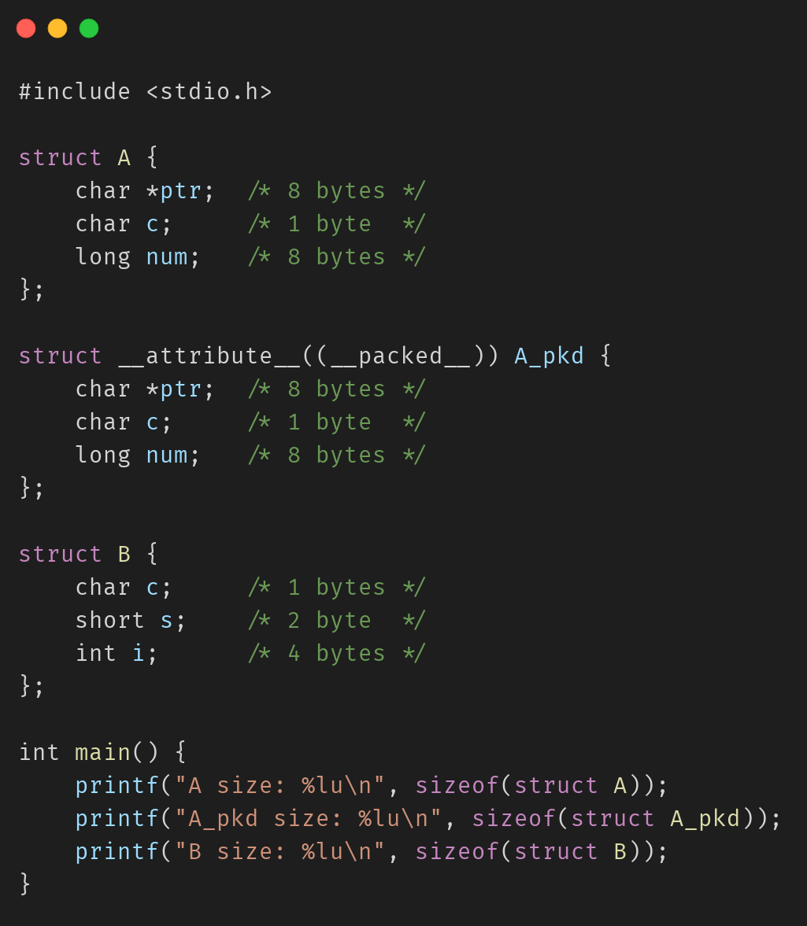
Packing in C
What do you think the following output will be? (Note: __packed__ will remove padding.)
What are the sizes of each struct?
A
A_pkd
B

Slide 23
Packing in C
What do you think the following output will be? (Note: __packed__ will remove padding)
What are the sizes of each struct?
A: 24 bytes
A_pkd: 17 bytes
B: 8 bytes

Slide 24
Packing Example
struct Q {
char c; /* 1 bytes */
short s; /* 2 bytes */
int i; /* 4 bytes */
};
 | +0 | +1 | +2 | +3
0x00
0x04

Slide 25
Packing Example
struct Q {
char c; /* 1 bytes */
short s; /* 2 bytes */
int i; /* 4 bytes */
};
 | +0 | +1 | +2 | +3
0x00 | c |  | s0 | s1
0x04 | i0 | i1 | i2 | i3

Slide 26
Circuit Sim

Slide 27
Circuit Sim Installation
More specific instructions on Canvas > Modules > Projects > CircuitSim Downloads
https://ra4king.github.io/CircuitSim/download

Slide 28
Thanks for Attending :)

